Slide 1
MOD003216
Quality Assurance
in Game Development

Slide 2
Define and classify a bug by severity and priority and describe the relationship between them.

Slide 3
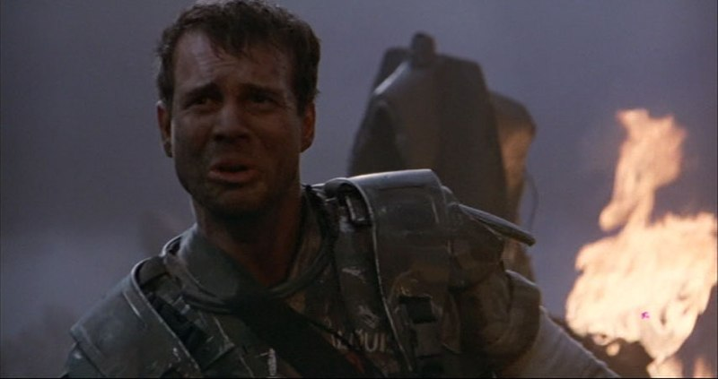
Bugs
“Is this going to be a stand up fight, sir, or another bughunt?”
– Hudson, Aliens

Slide 4
Definition
An unexpected defect, fault, flaw or imperfection

Slide 5
Severity & Priority
How bad is the problem?
How important is it to fix?
Different, but sometimes combined together

Slide 6
Severity
Minor
no effect on gameplay, low effect on perception (e.g. missing barrel shadow)
Moderate
mild effect on gameplay or perception (e.g. robot missing death animation)

Slide 7
Severity
Major
serious effect on gameplay or perception (e.g. bugged robot A.I., one way door)
Severe
stops gameplay (e.g. falling off world, crash, lock-up or save-file corruption)

Slide 8
Priority
How soon should the bug be fixed?
Low
mañana
Medium
should be fixed soon™
High
must fix soon
Critical
now!

Slide 9
Severity\Priority | Low | Medium | High | Critical
Minor | infrequent or common | ubiquitous | - | -
Moderate | infrequent | common | ubiquitous | -
Major | occurs rarely, workaround possible | common or no workaround | frequent, affects balance or difficulty | blocks primary path
Severe | - | rare occurrence, off primary path | common or near primary path | at any moment, on or near primary path
Notes:
Colour Coding:
Red – cannot release any game with these elements unfixed (assuming you know about them)
Yellow – no AAA game should release with these bugs unfixed (open world games get a slight get-out because of their vast size and complexity)
Green – ideally, these bugs should be fixed as soon after launch as possible, if not before

Slide 10
Interdependency
Some bugs only exist because of others
if you couldn’t climb on top of the walls because of a bug, falling through the geometry wouldn’t matter
Sometimes the fix for one bug is needed before another can be worked on

